Slide 1

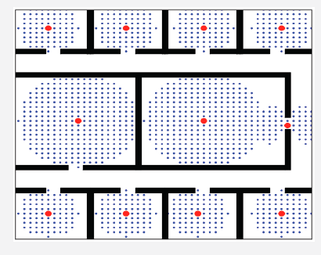

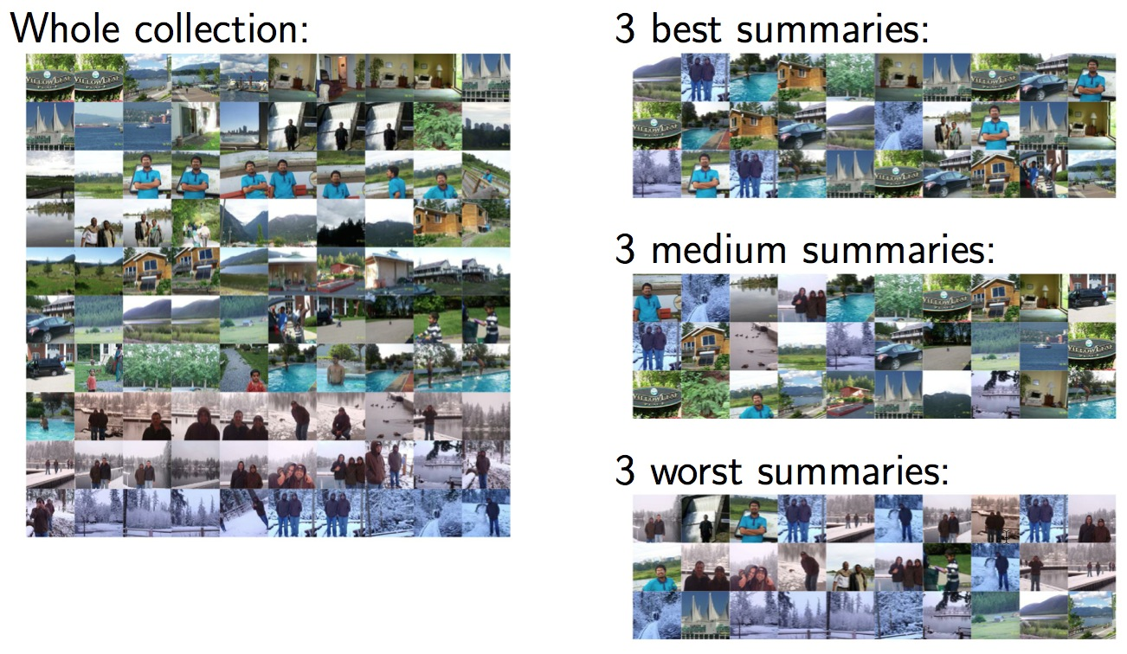
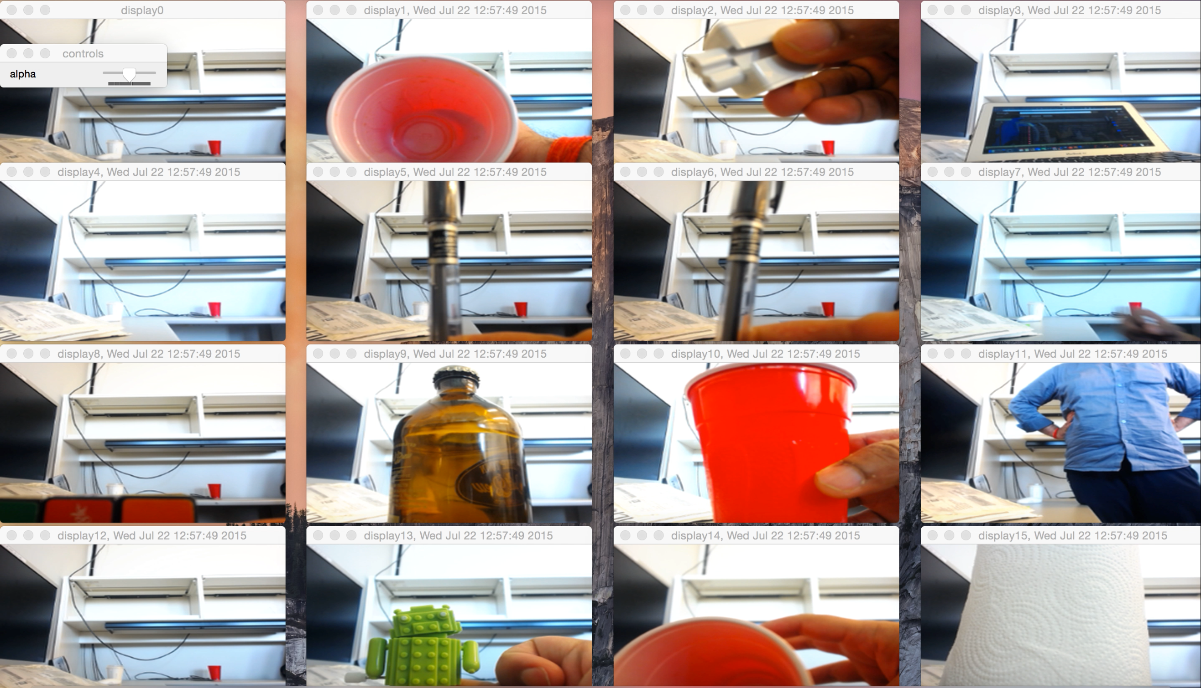
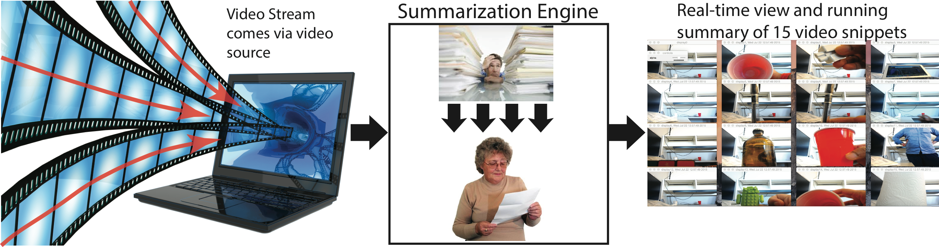
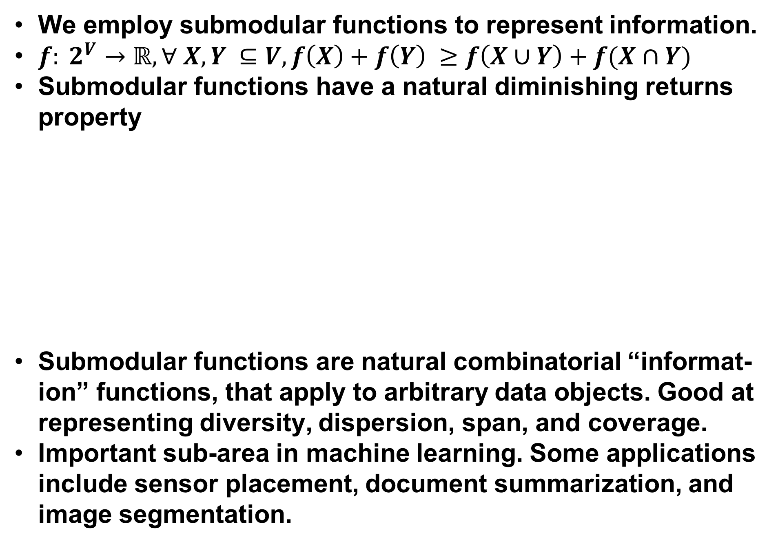
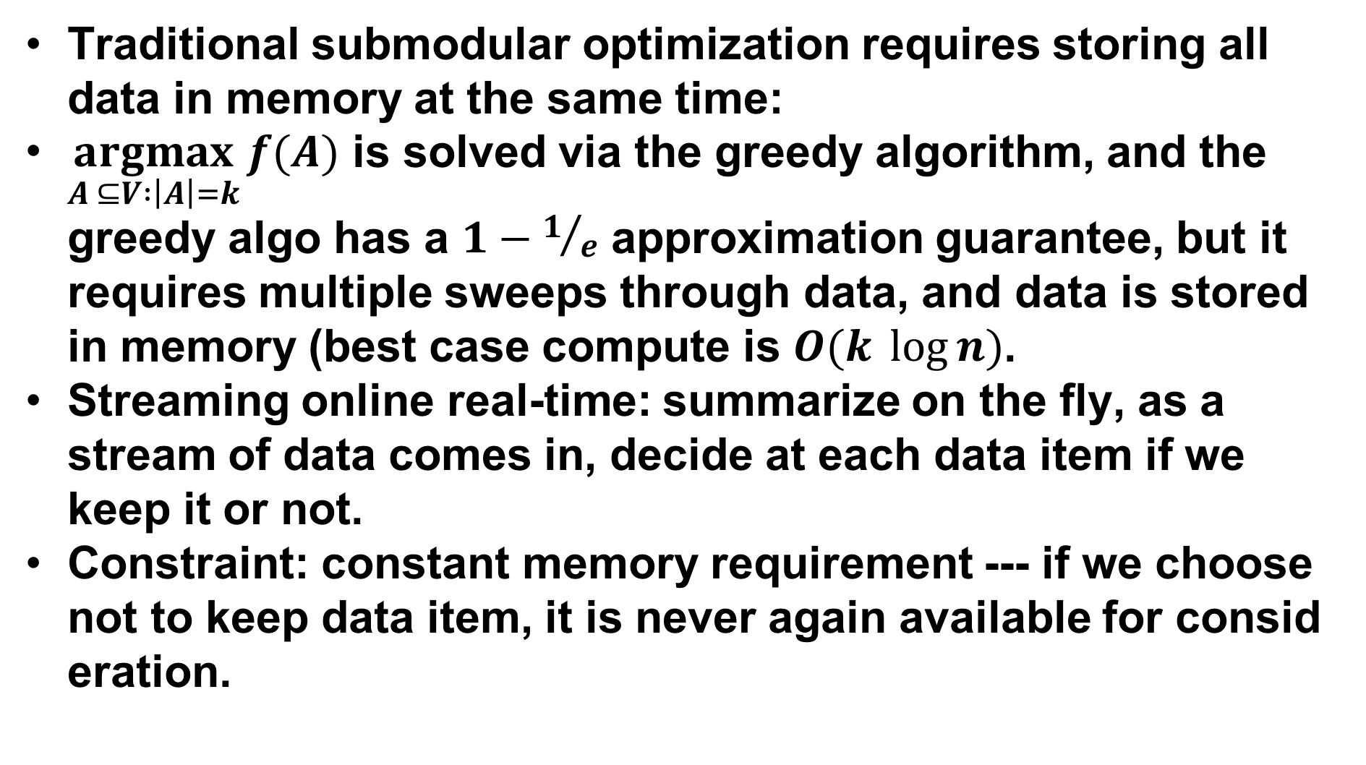
Dynamic Video-Stream Running Summarization
October 4, 2013
Chandrashekhar Lavania, Rishabh Iyer, Jeffrey A. Bilmes,
Motivation & Problem
Submodular Applications in ML
Streaming Summarization Process
Exists massive quantities of Videos and Live Video Streams
Too large to store; too long to view (by humans); and too resource intensive to process in batch.
Mostly uninteresting & ordinary; plagued with redundancy; surveillance is costly, tedious, and error-prone.
Sensor Placement
Document Summarization
Image Collection Summarization
Divide incoming video stream into video snippets (snippet length is adjustable).
As shown: a snippet consists of a 3-second temporal sequence of successive video frames.
At the start, we add first 𝒌 incoming snippets to the summary (𝒌 is the summary budget, and also can be adjustable, but for the demo we set 𝒌=𝟏𝟓).
On arrival of next snippet, decide to swap it with an existing snippet if submodular function gain of a swap is above a certain threshold.
Once swapped out, old snippet is no longer available --- hence, constant memory requirements even for unboundedly long stream lengths.
Overall memory cost is no more than the size of the summary (𝒌 in this case) since entire stream is not processed simultaneously.
Aim: Running Video Summarization
Automatically summarize incoming video stream online, in real time, using few compute resources (standard laptop).
Video summarization: extract video “snippets” that toge- ther represent the video history relative to the current time
Online algorithm: process data dynamically as it comes in, in a stream, rather than all at once in batch.
Running summarization: summary of current history avail-able and viewable at any time, and in real time.
Useful for: surveillance, quick video “gisting”, reducing storage requirements, reducing computational resources, reducing the deluge of big data streams.
Other applications: image segmentation, graphical models, (image) denoising, data subset selection and active learning, auctions, diverse selection, signal encoding and sparse codes/structured convex norms, data partitioning, parallel computing, clustering, feature selection in pattern recognition, etc.
Our Approach: Real-Time
Streaming Submodular Optimization
Example Summary
Submodular Functions
Traditional submodular optimization requires storing all data in memory at the same time:
$\underset{A ⊆V :\left|A\right|=k}{argmax}{f(A)}$ is solved via the greedy algorithm, and the greedy algo has a $1−1/e$ approximation guarantee, but it requires multiple sweeps through data, and data is stored in memory (best case compute is $O(k \log{n})$.
Streaming online real-time: summarize on the fly, as a stream of data comes in, decide at each data item if we keep it or not.
Constraint: constant memory requirement --- if we choose not to keep data item, it is never again available for consideration.
Live video feed is shown on upper left.
The other 15 frames show the 15 snippets that are currently chosen --- algorithm may swap one of them out, and a new one in, when it decides that something representable/novel enough has occurred.
We employ submodular functions to represent information.
$f: 2^{V}→ℝ, ∀ X,Y ⊆V, f\left(X\right)+f\left(Y\right) ≥f\left(X∪Y\right)+f(X∩Y)$
Submodular functions have a natural diminishing returns property
Submodular functions are natural combinatorial “informat-ion” functions, that apply to arbitrary data objects. Good at representing diversity, dispersion, span, and coverage.
Important sub-area in machine learning. Some applications include sensor placement, document summarization, and image segmentation.

